Slide 1
Temporally-Aware, Explainable Multimodal Sleep Stage Classification with LLM-Generated Reports and Cross-Dataset Validation
23AID498 Project Phase 1 – Approval Presentation
Team ID: 23UG103 Panel No.: 8
S.No | Reg.No | Name of the Student | Branch
1 | BL.EN.U4AID23019 | Joshika Somisetty | AID
2 | BL.EN.U4AID23037 | Padarthi Leela Sabareesh | AID
3 | BL.EN.U4AID23056 | Vobilisetti Vyvanth | AID
Project Guide: Dr. Sreevidya B.
Vice Chairperson, School of Computing, Bengaluru

Slide 2
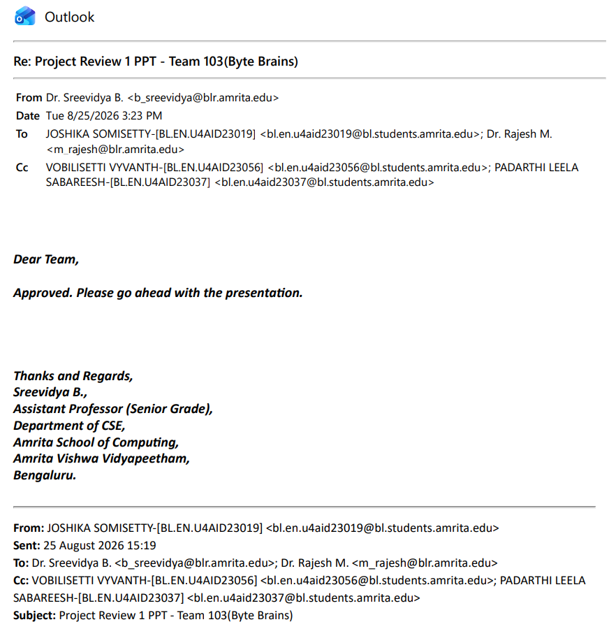

Slide 3
Problem Definition
Existing automated sleep staging systems classify each 30-second PSG epoch independently, ignoring the sequential nature of sleep — causing poor accuracy on the N1 transition stage.
Classifiers operate as black boxes, offering no explanation for why a stage was predicted, limiting clinical trust in the output.
Systems are typically validated on a single dataset only, leaving real-world generalization untested across different recording setups and populations.
This project proposes a temporally-aware, explainable sleep stage classification framework combining sequence modeling, SHAP-based explainability, LLM-generated clinical reports, and cross-dataset validation (Sleep-EDF → ISRUC-Sleep).

Slide 4
Literature Survey
S.No. | Authors name(s) | Full title of the paper with year | Inference from the paper | Open Problem (For proposed work)
1 | Satapathy, S.K., et al. (2024) | Machine learning-empowered sleep staging classification using multi-modality signals | ReliefF feature selection with AdaBoost on EEG, EOG, EMG signals | Single-dataset evaluation only; no explainability; no temporal modeling
2 | Chengfan, L., et al. (2022) | A Deep Learning Method Approach for Sleep Stage Classification with EEG Spectrogram | Compared CNN, LSTM, CNN+LSTM on EEG spectrograms; best accuracy 87.4% | Per-epoch classification only; no explainability; no cross-dataset validation
3 | Jia, Z., et al. (2020) | GraphSleepNet: Adaptive Spatial-Temporal Graph Convolutional Networks for Sleep Stage Classification | Graph-based spatial-temporal modeling of multi-channel EEG | Complex graph model with no explainability; not clinically interpretable
4 | et al. (2024) | Single-Channel Sleep EEG Classification Method Based on LSTM and Hidden Markov Model | LSTM + HMM combination to model temporal dependency across epochs | Single-channel EEG only; no explainability; no cross-dataset validation

Slide 5
Literature Survey
S.No. | Authors name(s) | Full title of the paper with year | Inference from the paper | Open Problem (For proposed work)
5 | et al. (2024) | ECG-SleepNet: Multimodal Sleep Stage Classification | Combines ECG and EEG signals in a deep multimodal architecture | No explainability layer; validated on a single dataset only
6 | et al. (2025) | Sequential feature engineering with XGBoost for sleep stage classification | Sequential feature construction improves temporal consistency of tree-based classifier | No explainability mechanism; no cross-dataset validation
7 | et al. (2026) | SleepExplain: Explainable NREM and REM Sleep Stage Classification from EEG Signal | Attribution-based explainability for EEG-based sleep stage predictions | Two-class (NREM/REM) only, not full 5-stage; no LLM-based reporting
8 | Tallal, U., et al. (2026) | STDA-Net: Spectrogram-Based Domain Adaptation for Cross-Dataset Sleep Stage Classification | CNN + BiLSTM + domain-adversarial network for cross-dataset spectrogram-based staging | No explainability; EEG-only, not multimodal with EOG/EMG
9 | et al. (2023) | SSNet: Sequential Sleep Staging Network Using EEG, EOG, and EMG | Sequential deep network jointly using EEG, EOG, and EMG signals | No explainability mechanism; validated on a single dataset
10 | Amato, A. (2026) | A Federated Deep Learning Framework for Sleep-Stage Monitoring Using the ISRUC-Sleep Dataset | Federated learning (FedAvg/FedProx/FedBN) on ISRUC-Sleep; heterogeneity limits generalization | No temporal modeling (single-epoch CNN); no explainability; motivates heterogeneity-aware cross-dataset validation

Slide 6
Justification for the Proposed Problem
Sleep is a continuous physiological process; treating epochs independently discards clinically meaningful context — modeling temporal dependency can directly improve accuracy on the hardest stage, N1.
Black-box predictions limit clinical adoption; attaching explainable, evidence-based reasoning to each prediction (and to the generated report) builds clinician trust.
Single-dataset validation cannot establish real-world robustness; testing on ISRUC-Sleep demonstrates whether the model generalizes beyond its training distribution.
Together, these enhancements move the system from a proof-of-concept classifier toward a clinically credible decision-support tool.

Slide 7
Architecture of the Proposed System
1. Signal Acquisition & Preprocessing — EEG, EOG, EMG channels; wavelet denoising; epoching; per-subject Z-score normalization.
2. Feature Extraction & Multi-Metric Selection — time/frequency-domain features, Hjorth parameters, permutation entropy, TKEO.
3. Baseline Epoch-Wise Classification — LightGBM with hybrid SMOTE + RUS sampling.
4. Temporal Modeling Layer — BiLSTM/Transformer over epoch sequences, or HMM/CRF smoothing of stage probabilities.
5. Explainability Layer — SHAP-based per-epoch feature attribution.
6. LLM-Based Report Generation — explanations grounded in feature attributions, not just aggregate metrics.
7. Cross-Dataset Validation — trained model applied to ISRUC-Sleep to test generalization.

Slide 8
Functionalities of the Proposed System
Multimodal PSG preprocessing and feature engineering pipeline.
Temporal sleep stage classification with improved N1-stage accuracy.
Per-epoch explainability using SHAP feature attribution.
Explainable LLM-generated sleep reports referencing physiological evidence.
Comparative evaluation: independent-epoch baseline vs. temporal model.
Cross-dataset generalization testing on the ISRUC-Sleep dataset.

Slide 9
Software/Tools Requirements
Programming: Python 3.x
Signal Processing: MNE-Python, PyEDFlib, PyWavelets
Machine Learning: scikit-learn, LightGBM, imbalanced-learn (SMOTE)
Temporal Modeling: PyTorch / TensorFlow-Keras (BiLSTM, Transformer), hmmlearn
Explainability: SHAP
LLM Integration: Gemini API / OpenAI API
Evaluation: BERTScore, judge-LLM prompting
Environment: Google Colab / Jupyter Notebook, GPU runtime
Version Control: Git & GitHub

Slide 10
Data Set
Dataset 1: Sleep-EDF Expanded
Source: https://physionet.org/content/sleep-edfx/
197 whole-night PSG recordings (EEG, EOG, EMG); used to build and train the baseline, temporal, and explainability pipeline.
Dataset 2: ISRUC-Sleep
Source: https://sleeptight.isr.uc.pt/
126 PSG recordings including healthy subjects and subjects with sleep difficulties; used as an independent dataset for cross-dataset generalization validation.

Slide 11
Timeline
Literature Survey
Design [Front End, Back End]
Implementation
Testing
Document Submission
<September/October 2026>
<January 2027>
<March 2027>
<April 2027>
Abstract Submission
<August 2026>
<August 2026>

Slide 12
Conclusion
This project extends automated sleep staging with temporal context modeling, physiological explainability, and cross-dataset validation.
Expected outcome: improved N1-stage classification, transparent per-epoch explanations reflected in LLM-generated reports, and demonstrated generalization on ISRUC-Sleep.
The result is a more clinically credible, trustworthy, and robust sleep staging system than existing epoch-independent, black-box approaches.

Slide 13
References
[1] N. Sreekumar, J. Velayudhan, and A. Veluppal, “Multimodal Sleep Stage Classification with LLM based Sleep Report,” in Proc. 2nd Int. Conf. Next Generation Electronics (NELeX), 2026.
[2] X. Xu et al., “An Effective and Interpretable Sleep Stage Classification Approach Using Multi-Domain Electroencephalogram and Electrooculogram Features,” Bioengineering, vol. 12, no. 3, p. 286, 2025.
[3] S. K. Satapathy et al., “Machine learning-empowered sleep staging classification using multi-modality signals,” BMC Medical Informatics and Decision Making, vol. 24, no. 1, p. 119, 2024.
[4] B. Kemp et al., “Analysis of a sleep-dependent neuronal feedback loop: the slow-wave microcontinuity of the EEG,” IEEE Trans. Biomed. Eng., vol. 47, no. 9, pp. 1185–1194, 2000.
[5] S. Khalighi, T. Sousa, J. M. Santos, and U. Nunes, “ISRUC-Sleep: A comprehensive public dataset for sleep researchers,” Computer Methods and Programs in Biomedicine, vol. 124, pp. 180–192, 2016.
[6] L. Chengfan, Q. Yueyu, and D. Xuehai, “A Deep Learning Method Approach for Sleep Stage Classification with EEG Spectrogram,” Int. J. Environ. Res. Public Health, vol. 19, no. 10, p. 6322, 2022.
[7] Z. Jia et al., “GraphSleepNet: Adaptive Spatial-Temporal Graph Convolutional Networks for Sleep Stage Classification,” in Proc. 29th Int. Joint Conf. Artificial Intelligence (IJCAI), 2020.
[8] U. Tallal, S. Kshirsagar, and A. Shukla, “STDA-Net: Spectrogram-Based Domain Adaptation for Cross-Dataset Sleep Stage Classification,” arXiv preprint arXiv:2605.06736, 2026.
[9] “SleepExplain: Explainable Non-Rapid Eye Movement and Rapid Eye Movement Sleep Stage Classification from EEG Signal,” arXiv preprint arXiv:2606.07351, 2026.
[10] A. Amato, “A Federated Deep Learning Framework for Sleep-Stage Monitoring Using the ISRUC-Sleep Dataset,” Appl. Sci., vol. 16, no. 2, p. 1073, 2026.

Slide 14
THANK YOU

